Slide 1
BATCH 8
THE SYMPHONY OF PNEUMONIA DETECTION
ASHISH A V(142221205011), HARISH KUMAAR (142221205039), GANESH M D (142221205029), BOGESH P (142221205014)
SRM VALLIAMMAI ENGINEERING COLLEGE

Slide 2
BASE PAPER
INTRODUCTION
OBJECTIVES
LITERATURE SURVEY
EXISTNG SYSTEM AND
PROPOSED SYSTEM
CONTENTS
SOFTWARE AND HARDWARE REQUIREMENTS
ARCHITECTURE DIAGRAM
PROPOSED MODULES DESCRIPTION
REFERENCES

Slide 3
BASE PAPER
GENERATING CHEST X-RAY PROGRESSION OF PNEUMONIA USING CONDITIONAL CYCLE GENERATIVE AVERSARIAL NETWORK
AUTHORS -YEONGBONG JIN, WOOJIN CHANG, BONGGYUN KO
YEAR - 2023
RECEIVED 29 JULY 2023, ACCEPTED 8 AUGUST 2023, DATE OF PUBLICATION 17 AUGUST 2023, DATE OF CURRENT VERSION 23 AUGUST 2023.
DIGITAL OBJECT IDENTIFIER 10.1109/ACCESS.2023.3305994. VOLUME 11 2023.

Slide 4
INTRODUCTION
INTRODUCTION TO PNEUMONIA DETECTION: DEEP LEARNING APPROACH
Healthcare Challenge:
Pneumonia poses a significant global health challenge, causing a substantial number of hospitalizations and fatalities.
Traditional diagnostic methods, such as X-rays, are effective but time-consuming, leading to a growing need for faster and more efficient detection techniques.
2. Rise of Deep Learning:
Deep learning, a subset of artificial intelligence, has emerged as a powerful tool in medical image analysis.
Leveraging convolutional neural networks (CNNs), deep learning models can learn intricate patterns and features from medical images, potentially revolutionizing pneumonia detection.
3. Objective of the Study:
This study explores the application of deep learning algorithms in pneumonia detection from chest X-rays.
By examining the accuracy and efficiency of deep learning models, the aim is to enhance early and accurate diagnosis, ultimately improving patient outcomes in the realm of pneumonia detection.

Slide 5
OBJECTIVES
ENHANCE ACCURACY AND SPEED OF DIAGNOSIS:
To Develop a deep learning model capable of accurately detecting pneumonia from medical imaging, such as chest X-rays or CT scans.
To Aim to achieve high sensitivity and specificity to minimize false positives and negatives, respectively.
To Improve the speed of diagnosis by leveraging the computational efficiency of deep learning algorithms, contributing to timely medical interventions.
ENABLE EARLY DETECTION AND INTERVENTION:
To Focus on early detection of pneumonia to facilitate prompt medical intervention and improve patient outcomes.
Train the deep learning model to identify subtle signs of pneumonia at an early stage, allowing for timely treatment and reducing the risk of complications.
To Evaluate the model's performance in detecting pneumonia in diverse patient populations, considering factors such as age, gender, and underlying health conditions.
FACILITATE INTEGRATION INTO CLINICAL WORKFLOW:
ToDesign the deep learning system to seamlessly integrate into existing clinical workflows, ensuring practical usability for healthcare professionals.
To Provide an interpretable and transparent decision-making process to enhance trust and acceptance among medical practitioners.
To Conduct rigorous validation and testing in real-world clinical settings to assess the model's reliability, scalability, and generalizability across different healthcare institutions.

Slide 6
LITERATURE SURVEY
T. Rahman, E.H. Muhammad , 2020, [1] used digital x-ray images to detect the bacterial and viral pneumonia. Four different pre-trained deep Convolutional Neural Networks (CNN): Alex Net, ResNet18, DenseNet201, and Squeeze Net were used for transfer learning. This proposed study can be useful in quickly diagnosing pneumonia by the radiologist .
Alhazmi Lamia, Alassery Fawaz, 2022, [2] Developing a mobile app utilizing deep learning for pneumonia diagnosis addresses the challenge of limited experts and diagnostic tools. The research focuses on creating a user-friendly prototype using Create ML, eliminating complexities in neural network configuration. With over 5,000 real images, the image classification model ensures accessible pneumonia detection via a mobile application. The simplified process eliminates concerns about network layers, parameter initialization, and algorithm choices. Create ML's graphical interface makes training the model easy without requiring specialized knowledge Are Identified in This Research.
EL. Khalid , Asnaoui, 2021 [3] Different types of single and ensemble learning models were utilized to classify pneumonia. Ensemble learning involves combining multiple models into a single model to tackle a specific task, with the choice of models being determined by the requirements and characteristics of the problem at hand. Currently, ensemble models are commonly employed for making predictions, including classification and regression tasks. By training a single model independently within an ensemble, improved accuracy can be achieved. In particular, an ensemble of three models demonstrated higher accuracy in this study.

Slide 7
Shimpy Goyal, Rajiv Singh, 2021 [4] In response to the novel Covid-19, research efforts have surged worldwide to accurately predict the disease. This paper proposes a framework using chest X-ray images for predicting lung diseases, including pneumonia and Covid-19. The innovative approach involves dataset acquisition, image quality enhancement, precise region of interest estimation, and disease anticipation, demonstrating robustness and efficiency compared to existing methods Are Examined In This Research
Wasif Khan, Nazar Zaki , 2021 [5] This helps practitioners to select the most effective and efficient methods from a real-time perspective, review the available datasets, and understand the results obtained in this domain. The usability, goodness aspects, and computational complexity of the algorithms used for intelligent pneumonia identification are examined in this research.
Patrik Szepesi, La´szlo´Szila´gyi, 2022 [6] The objective and automated detection of pneumonia represents a serious challenge in medical imaging, because the signs of the illness are not obvious in CT or X-ray scans. Further on, it is also an important task, since millions of people die of pneumonia every year. The main goal of this paper is to propose a solution for the above mentioned problem, using a novel deep neural network architecture. The proposed novelty consists in the use of dropout in the convolutional part of the network. The proposed method was trained and tested on a set of 5856 labeled images available at one of Kaggle’s many medical imaging challenges. The chest X-ray images (anterior-posterior) were selected from retrospective cohorts of pediatric patients, aged between one and five years, from Guangzhou Women and Children’s Medical Center, Guangzhou, China. Results achieved by our network would have placed first in the Kaggle competition with the following metrics: 97.2% accuracy, 97.3% recall, 97.4% precision and AUC ¼ 0:982, and they are competitive with current state-of-the-art solutions

Slide 8
EXISTING AND PROPOSED SYSTEM
EXISTING SYSTEM FOR PNEUMONIA DETECTION:
ENHANCING DIAGNOSTIC PRECISION WITH CT IMAGING:
Investigate and implement a deep learning model specifically designed for pneumonia detection utilizing computed tomography (CT) imaging, aligning with the World Health Organization's recommendation for improved diagnostic accuracy.
Address the limitations of chest X-ray imaging, characterized by inter-class variability, by leveraging the superior capabilities of CT scans in providing detailed and comprehensive information for pneumonia diagnosis.
MITIGATING DIAGNOSTICIANS SHORTAGE THROUGH AUTOMATION:
Develop an automated pneumonia detection system based on deep learning models, with a particular focus on overcoming the critical shortage of diagnosticians.
Utilize advanced architectures such as Generative Adversarial Networks (GANs) to enhance the efficiency of pneumonia detection from chest X-ray images, reducing dependence on expert radiologists and improving the accessibility of diagnostic services.
STANDARDIZING AND OBJECTIFYING PNEUMONIA DIAGNOSIS:
Validate the proposed deep learning model through comprehensive studies to ensure consistent and reliable performance across diverse patient populations and medical settings.
Address the subjective variability associated with X-ray examinations by providing a standardized and objective approach to pneumonia diagnosis, thereby contributing to more consistent and accurate results.
Emphasize the potential of deep learning models, such as GANs, to significantly improve the accuracy of pneumonia diagnosis, paving the way for a more reliable and automated diagnostic process.

Slide 9
PROPOSED SYSTEM FOR PNEUMONIA DETECTION:
ADVANCING PNEUMONIA DETECTION WITH ENHANCED DEEP LEARNING MODELS:
Develop automatic detection models utilizing advanced deep learning techniques, specifically enhanced convolutional neural networks (CNN) and ensemble models, to overcome the limitations of the existing system relying on chest X-ray imaging.
Focus on improving both accuracy and efficiency in pneumonia detection, acknowledging the challenges associated with inter-class variability and the need for expert evaluation in traditional X-ray-based approaches.
AUTOMATION FOR EARLY AND ACCURATE DETECTION:
Leverage deep learning-based models to create an automated system tailored for early and accurate pneumonia detection from chest X-ray images.
Emphasize the potential of these models to contribute to improved patient outcomes by facilitating timely interventions and reducing dependence on manual expert evaluation.
MITIGATING LIMITATIONS OF TRADITIONAL X-RAY APPROACHES:
Highlight the limitations of the existing pneumonia detection system based on chest X-ray imaging, including inter-class variability.
Showcase the potential of deep learning techniques, such as enhanced CNNs and ensemble models, to address these limitations and provide a more robust and accurate approach to pneumonia detection.
Summarize the proposed system's potential to revolutionize pneumonia diagnosis by offering a more automated and advanced solution compared to traditional methods.

Slide 10
HARDWARE AND SOFTWARE REQUIREMENTS
HARDWARE REQUIREMENTS:
LAPTOP Or PC
SOFTWARE REQUIREMENTS:
WINDOWS 11
PYTHON
JUPYTERNOTEBOOK
VISUAL STUDIO CODE

Slide 11
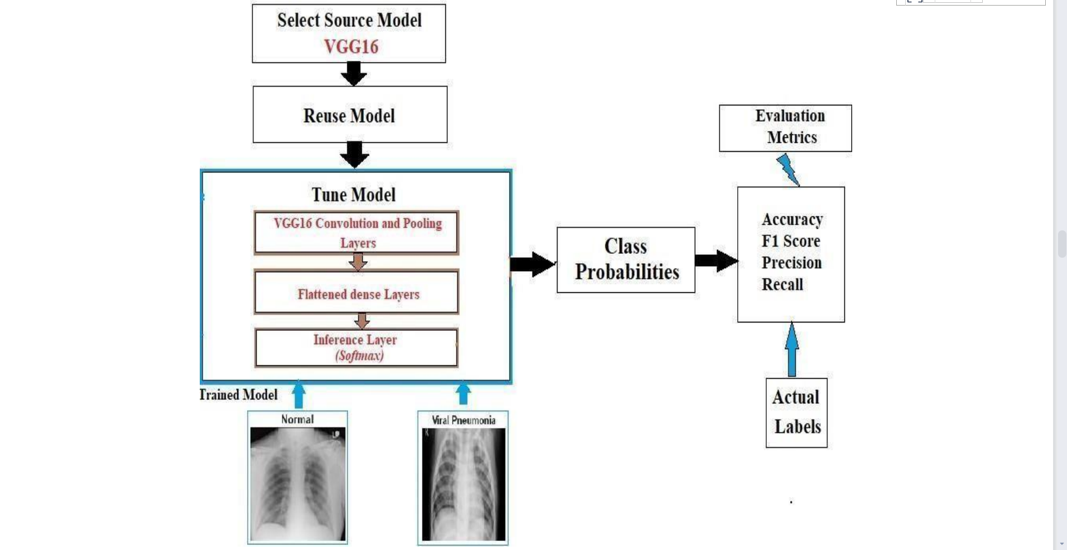
ARCHITECTURE MODEL DIAGRAM

Slide 12
PROPOSED MODULE DESCRIPTION
MODULE 1: DATA PREPROCESSING
OBJECTIVE: Prepare and clean the dataset for effective model training.
TASKS:
1. Data Collection: Gather a diverse dataset of chest X-ray images, including both pneumonia and normal cases.
2. Data Cleaning: Remove any corrupted or irrelevant images from the dataset.
3. Data Augmentation: Enhance the dataset by applying transformations like rotation, flipping, and scaling to avoid overfitting.
4. Normalization: Standardize pixel values to ensure consistent input for the model.
5. Splitting: Divide the dataset into training, validation, and testing sets.

Slide 13
MODULE 2: CONVOLUTIONAL NEURAL NETWORK (CNN) ARCHITECTURE
OBJECTIVE: Design and implement a deep learning model capable of detecting pneumonia in chest X-ray images.
TASKS:
1. Model Architecture: Choose an appropriate CNN architecture for image classification (e.g., VGG, ResNet, or custom architecture).
2. Input Layer: Define the input layer to handle the preprocessed images.
3. Convolutional Layers: Create multiple convolutional layers to capture hierarchical features.
4. Pooling Layers: Implement pooling layers to reduce spatial dimensions.
5. Fully Connected Layers: Add dense layers for final classification.
6. Activation Functions: Utilize activation functions like ReLU for non-linearity.
7. Dropout: Integrate dropout layers to prevent overfitting.
8. Output Layer: Design the output layer with a sigmoid activation function for binary classification.

Slide 14
MODULE 3: TRAINING AND OPTIMIZATION
OBJECTIVE:Train the deep learning model using the preprocessed dataset and optimize its performance.
TASKS:
1. Loss Function: Choose a suitable loss function for binary classification (e.g., binary cross-entropy).
2. Optimizer: Select an optimizer (e.g., Adam or SGD) for model weight updates.
3. Learning Rate: Fine-tune the learning rate for optimal convergence.
4. Training: Train the model on the training dataset and monitor performance on the validation set.
5. Model Evaluation: Assess the model's accuracy, precision, recall, and F1 score.
6. Hyperparameter Tuning: Adjust hyperparameters to enhance model performance.

Slide 15
MODULE 4: DEPLOYMENT AND INTEGRATION
OBJECTIVE: Deploy the trained model and integrate it into a user-friendly application or system.
TASKS:
1. Model Serialization: Save the trained model in a serialized format for easy deployment.
2. API Development: Create an API endpoint to handle incoming chest X-ray images and return predictions.
3. User Interface: Develop a user-friendly interface for users to interact with the model.
4. Deployment: Choose a deployment platform (e.g., cloud service or local server) to host the model.
5. Integration: Integrate the model into the chosen deployment platform.
6. Testing: Conduct thorough testing to ensure the deployed system works seamlessly.
7. Monitoring: Implement monitoring tools to keep track of model performance in real-time.

Slide 16
REFERENCES
1. DARNELL KIKOO , BRYAN TAMIN, Using Various Convolutional Neural Network to Detect Pneumonia from Chest X-Ray Images,(2023).
2. HAO REN , ASLAN B. WONG , WANMIN LIAN, Interpretable Pneumonia Detection by Combining Deep Learning and Explainable Models With Multisource Data,(2021)
3. ROHIT KUNDU, RITACHETA DAS, Pneumonia detection in chest X-ray images using an ensemble of deep learning models,(2021)
4. S. HOSSAIN, RAFEED RAHMAN, Pneumonia Detection by Analyzing Xray Images Using MobileNET ResNET Architecture and Long Short Term Memory(2020).
5. SAEED S. ALAHMARI , BADERALDEEN ALTAZI, JISOO HWANG, A Comprehensive Review of Deep Learning-Based Methods for COVID-19 Detection Using Chest X-Ray Images, (2022)
6. ANSH SAXENA, SHIVA SINGH TOMAR, Deep learning based Diagnosis of diseases using Image Classification(2021)
7. V. SIRISH KAUSHIK, ANAND NAYYAR, GAURAV KATARIA, RACHNA JAIN, Pneumonia Detection Using Convolutional Neural Networks (CNNs). (2020)
8. SHAOLIANG PENG, XIONGJUN ZHAO, Multi-View Weighted Feature Fusion Using CNN for Pneumonia Detection on Chest X-Rays(2021)
9. YAOMING LAI, GUANGMING LI, Pneumonia on CT: A Feasibility Study of Few-Shot Learning for Computerized Diagnosis of Emergency Diseases,(2020)
10. MOHAMMAD YASELIANI 1 , ALI ZEINAL HAMADANI1 , ABTIN IJADI MAGHSOODI, Pneumonia Detection Proposing a Hybrid Deep Convolutional Neural Network Based on Two Parallel Visual Geometry Group Architectures and Machine Learning Classifiers

Slide 17
THANKS
BATCH 8

